Slide 1
Publishing to GeoServer using PostgreSQL

Slide 2
Spatial Database Preparation
Make sure you have some spatial data loaded into your database
Know connection information
Host address
Port
Database name
Table
User and password

Slide 3
GeoServer
Login to GeoServer
Username = x500
Password = ‘student’

Slide 4
GeoServer
GeoServer is a JAVA program that can read spatial information and translate it into consumable services.
WMS
WFS
WCS
Lots of extensions and community add-ons
Extensions are maintained
Community add-ons individually supported

Slide 5
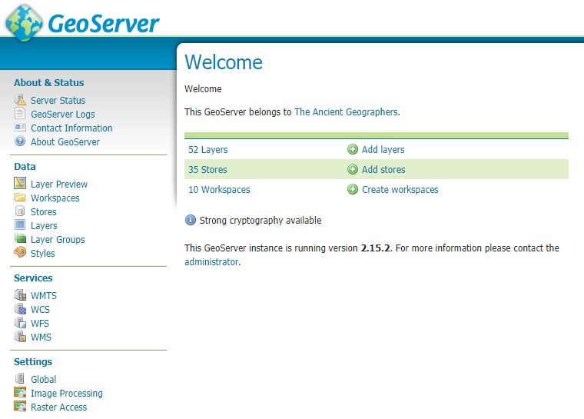
GeoServer
Layers
Tailored spatial datasets
Stores
Connections to collections of spatial data
Workspaces
Allow for name spacing and separation of data

Slide 6
GeoServer
Layer preview is always publicly accessible.
GeoServer has administrative controls for users.
GeoServer logs provides the Java stack trace for all errors. If something goes wrong look there.

Slide 7
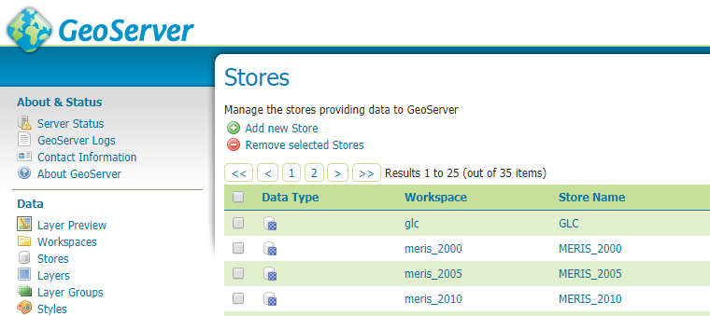
Adding a new store

Slide 8
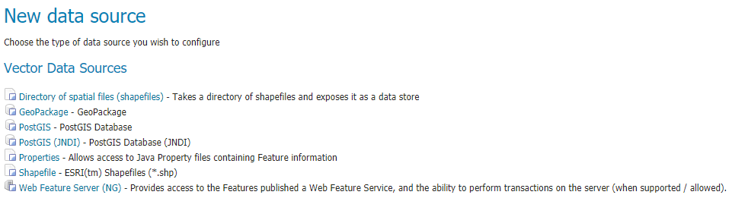
Add a new vector data source

Slide 9
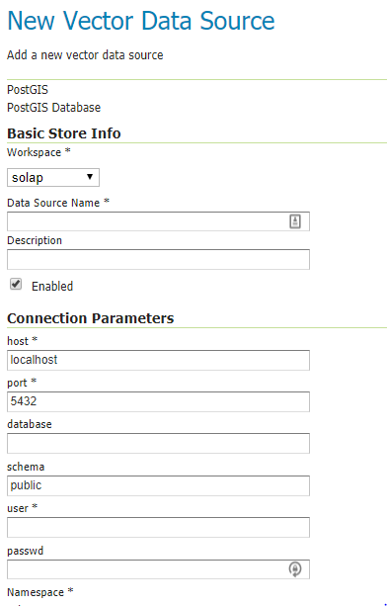
Setting up a Vector Data Source
Choose a workspace ‘GIS5577’
Data Source Name = x500_db
Description = “Put something useful here”
Host
Port
Database
User
password

Slide 10
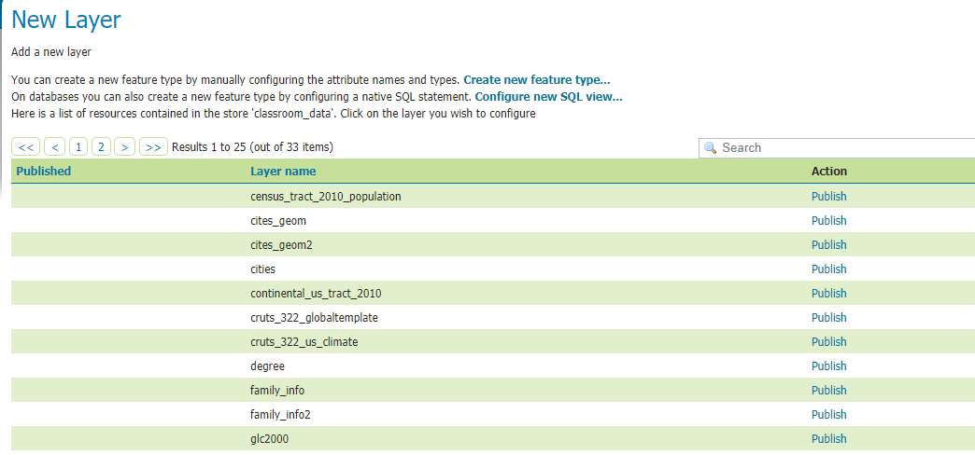
Success

Slide 11
Publishing Geospatial Data
Publish a table with a geometry column.

Slide 12
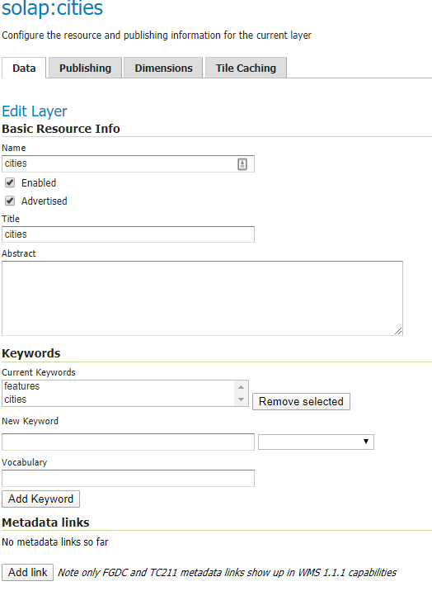
Publishing (part 1)
Change the name now if you want. This is how the web map application will request the layer.
Optional
Title
Abstract
Keywords

Slide 13
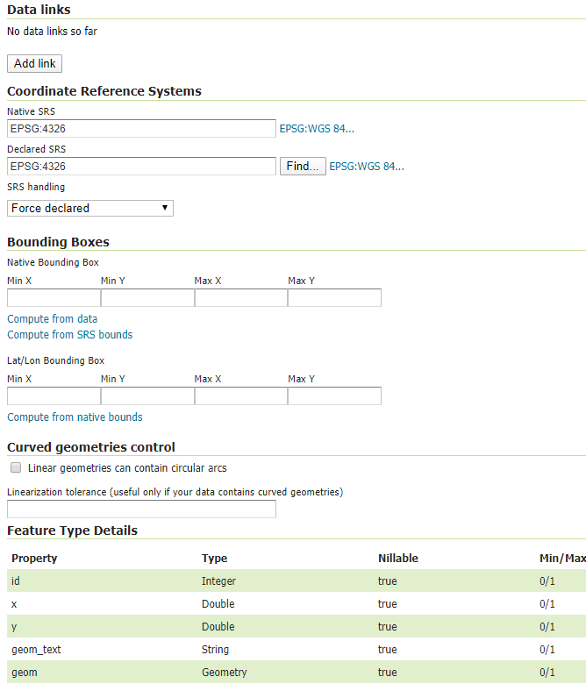
Publishing (part 2)
Coordinate Reference System needs to be what the actual dataset was loaded in.
Bounding Boxes
Click compute from data
Click compute from native bounds
Click Save at the bottom

Slide 14
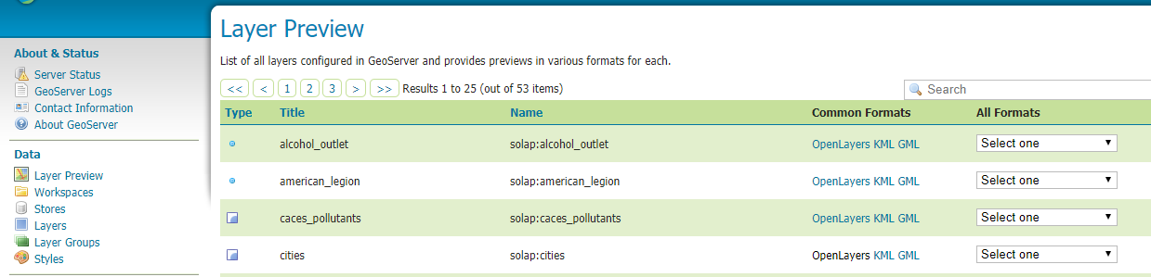
Previewing your Layer

Slide 15
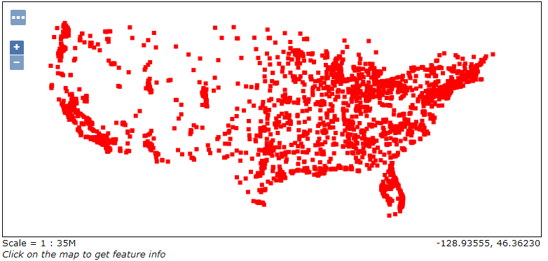
Success

